Slide 1
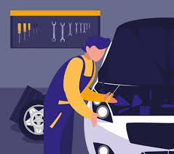
MOBILE-BASED ON ROAD VEHICLE BREAKDOWN ASSISTANCE SYSTEM
PREPARED BY: NURA SALISU MUHAMMAD (KPT/ODFEL/CST/20/042)
SUPERVISED BY: MAL. ABUBAKAR BALARABE

Slide 2
Table of Content
1
Abstract
2
Background of the Study
3
Problem Statement
5
Proposed System
6
Motivation
4
Existing
System
7
Aim and Objectives
8
Methodology
8
Summarize Literature Review
9
Conclusion
MOBILE-BASED ON ROAD VEHICLE BREAKDOWN ASSISTANCE SYSTEM

Slide 3

Abstract
The problem vehicle users facing while travelling is majorly the breakdown of vehicle on the road. Mobile-based on road vehicle breakdown assistance system is going to be a good solution for the people who seek help in the remote locations with mechanical issues of their vehicle. Users of the proposed system will be the registered public and they will get connected with a particular mechanic through the trustworthy assistance system because only the legally licensed and approved mechanics are enlisted in the system. In an existing system there are users who have their own mechanic database which is very minimal. And also they have no idea if their vehicles are broke down or had any mechanical issue in remote locations or any long distant locations from their known mechanic shops. In the proposed system here the users of system can search for list of mechanic at any location or the nearby locations which will help them in an unexpected situations raised by the mechanical issues of their vehicles. Mechanics and vehicle users will be interviewed by the project researcher and the system will be designed using flutter for the frontend and Python (Django) for the backend and SQLite3 will be used for the database, the above language combination forms the programming language for the system.

Slide 4
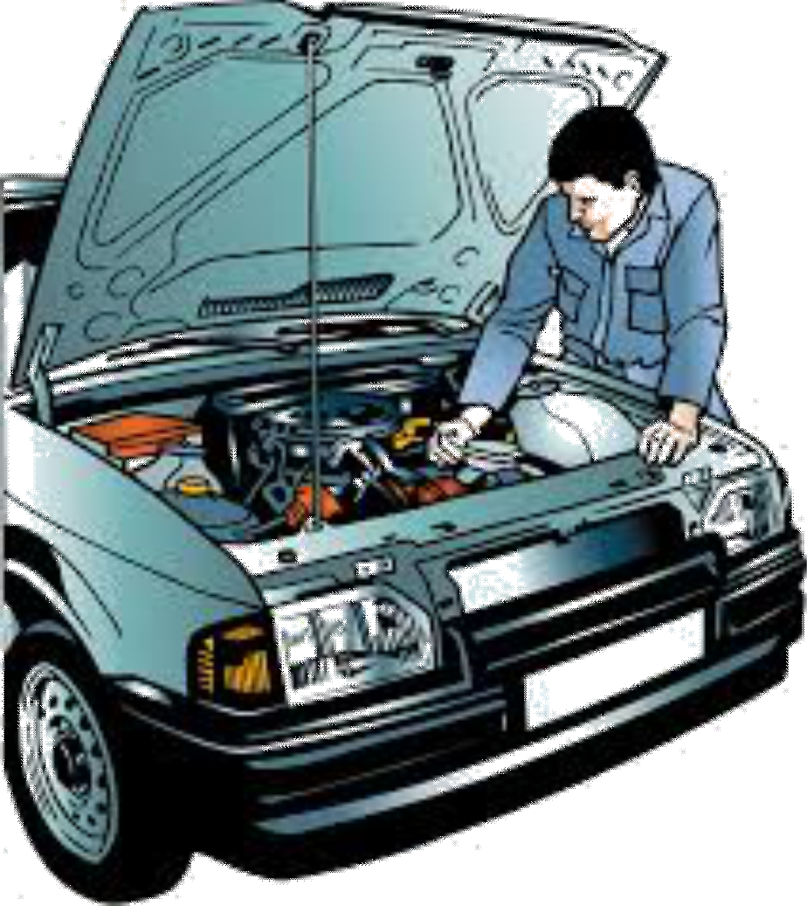
Background of Study
A lot of people are facing difficulties getting help when their car breaks down on the road. Many of them do not have any Car Repair Service Providers’ contact number and could not get help as the Car Repair Service Providers might be far away from their locations. These problems are the motivations for the development of this project to help those who are in need when their car breaks down along the roads. During the holiday seasons, cases of car breakdowns increase more as long trips put vehicles at greater risk of breakdown. In case of breakdown in the state route and the route in the city, it can be difficult to get help because if the driver is not familiar with that place. When it comes to breakdowns in rural areas, it could be worse since the breakdown point is far from the car repair service providers.
This application helps you to find your nearby service centers, exact locations with the distance from your place with the directions using Google Maps let you to know with ease to access with the help of this application on your smart mobiles.
The proposed mobile-based on road vehicle breakdown assistance system goal is to provide the system with the highest level of user-friendliness through efficiency, accuracy, availability and reliability that can be achieved through system performance. Information on the existing system is essential to achieve the goal of our project. The following are the methods used to locate facts

Slide 5

Statement of the problem
The problem while travel is breakdown of our vehicle. In this situation, the only way is to look for some other transportation at that time of issue and then they need to get a mechanic to the particular location at which they have left their vehicle. In this application, the mobile users can get nearby area mechanics by searching at anytime and anywhere. The admin can handle user management.

Slide 6

Existing system
1. In the existing system there are users who have their own mechanic number and it is also difficult for them to arrive at that remote location.
2. Vehicle might breakdown in locations where the driver might not know the environment or how to get to the next mechanic or how close to them it is.
3. Most times if breakdown happens the only way is to look for any other transportation at that time of issue and then they need to get a mechanic to the particular location at which they have left their vehicle
MOBILE-BASED ON ROAD VEHICLE BREAKDOWN ASSISTANCE SYSTEM

Slide 7

Proposed system
1. The proposed application helps to
find the nearby mechanics easily and quickly
2. This application shows the distance between the mechanic location in km from the driver location.
3. It allows us to search for the nearby mechanics from different locations and provides the mechanic contact information.
MOBILE-BASED ON ROAD VEHICLE BREAKDOWN ASSISTANCE SYSTEM

Slide 8
Motivation
Today most people use their own vehicle for travel. While travelling most of us encounters troubles with breakdown of our vehicle on the road. This is the worst experience they have to face.
Several of them don't have any vehicle Repair Service contact, even if they do, they might not get help because the vehicle Repair Service Providers may be distant from their locations. These issues are the motivations for the event of this project to assist those vehicle breaks down on the roads

Slide 9



Aim and Objectives of the Study
Aim
The project is aimed at designing a working mobile-based application to facilitate on-road vehicle breakdown
Objectives
1. To develop a platform that improves the efficiency of the driver and the mechanic.
2. To design and provide an estimated distance in km between the driver and the driver requested service
3. To build a common platform that connects the driver and the mechanic

Slide 10
Methodology
The method used for collecting data on this research work is interview, Questionnaires. This will be done by meeting some vehicle owner and mechanics for oral/verbal conversation or giving them questionnaires in order to get additional information that will be useful to this research work. This system is expected to be an independent application which will be designed using flutter for the frontend and Python (Django) for the backend and SQLite3 will be used for the database, the above language combination forms the programming language for the system
MOBILE-BASED ON ROAD VEHICLE BREAKDOWN ASSISTANCE SYSTEM

Slide 11
Summary of literature review
Title | Author & Year | Description | Merit | Demerits
A Vehicle Breakdown Service Provider System | Krishna et al. (2021). | The primary focus of this Vehicle Breakdown Service Provider System development is to solve the faults of existing market applications. | With the help of the system one can get access to nearby mechanic and contact them. | The system is ambiguous
On Road Vehicle Breakdown Services | Elakkiya and Bavithra (2020). | Our suggested service for emergency breakdowns provides a user-friendly environment. It is the most convenient technique to identify the place as well as surrounding required sites | Easy to use and provides both locations nearby | It robostness has not been tested in terms of emergency
In Campus Location Finder Using Mobile Application. | Low and Lukman (2021). | This project, an application for indoor and outdoor navigation at Universiti Tun Hussein Onn Malaysia created (UTHM). It is used to assist visitors and new incoming students by routing them from their current position to their destination utilizing the "U Finder" smartphone application. | The researcher achieved its stated objective as the indoor and outdoor navigation was fully effective and functional. | Indoor navigation lacks real-time navigation as it was built with QrCode indoor navigation.

Slide 12

Summary
As a consequence, our emergency vehicle breakdown service provides superior location results. Our programme quickly detects nearby locations, which is extremely valuable for users in emergency situations. It also features an offline mode that provides recommendations when the internet is not available. This technique simplifies the user experience and outperforms the old system in critical situations
MOBILE-BASED ON ROAD VEHICLE BREAKDOWN ASSISTANCE SYSTEM

Slide 13


Thank you

